Slide 1




ASTOCK
AI-Powered Stock Intelligence Tool
ML HACKATHON
Dipankar Roy • Shubham Gupta • Firdos Khatoon • Ansuman Shaw
Notes:
1

Slide 2

Problem
Stock market data is complex
Beginners struggle to analyze stocks
Risk is difficult to understand
Notes:
2

Slide 3
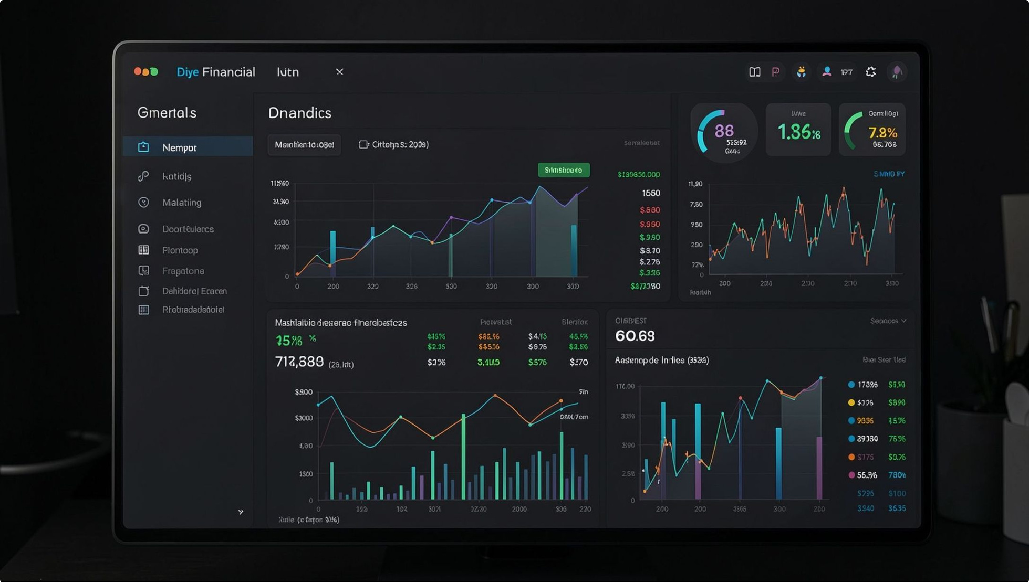


Market Gap
Most tools only show data
No actionable insights
Few tools provide predictions
AI forecasting is rare
Not beginner-friendly
Too technical for new investors
Notes:
3

Slide 4
Solution
AI & Machine Learning
Predict Return & Risk
One Simple Dashboard
Astock uses advanced ML models to analyze market patterns
Get a clear return prediction and risk score instantly
All results displayed in a clean, easy-to-read interface
Notes:
4

Slide 5
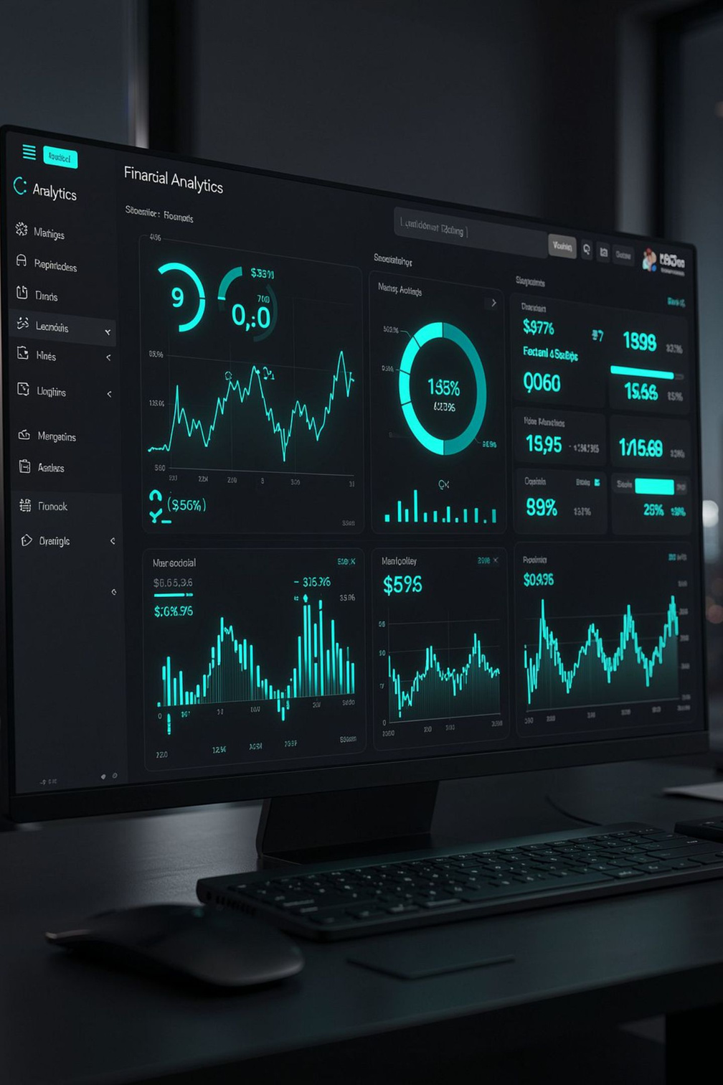




Features
Return Prediction
AI-powered forecast of expected stock returns
Risk Score
Clear risk rating so you know what you're investing in
Live Market Data
Real-time stock prices and market updates
Smart Stock Search
Find and compare stocks quickly and easily
Notes:
5

Slide 6

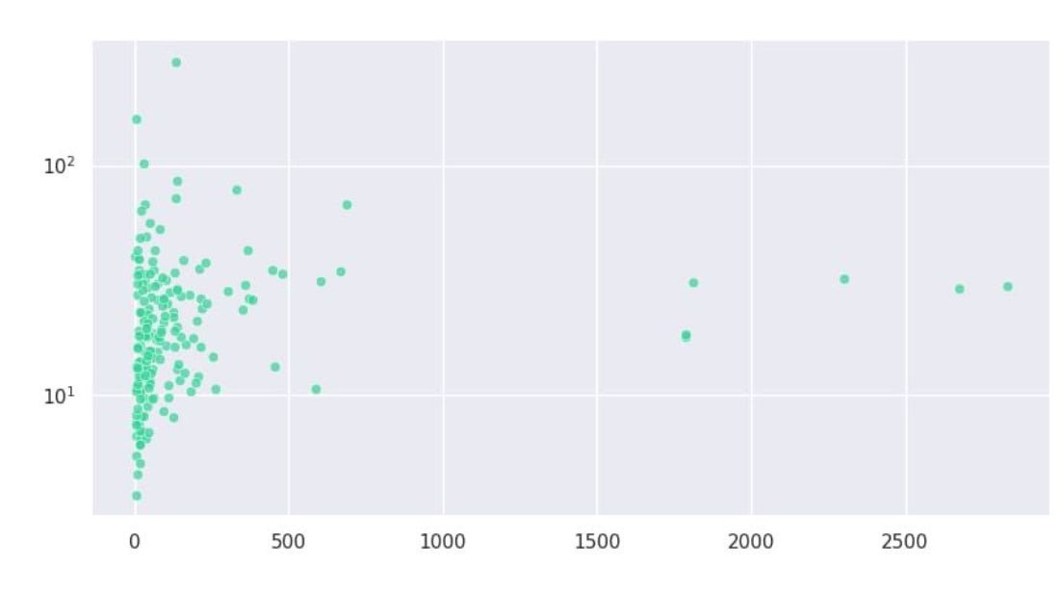
How It Works
Process with AI
Collect Data
Generate Prediction
Display Dashboard
Notes:
6

Slide 7


Technology Stack
React & Next.js
Python & FastAPI
Modern frontend framework
Fast and scalable backend
Machine Learning
Yahoo Finance API
Predictive AI models
Live market data source
Notes:
7

Slide 8
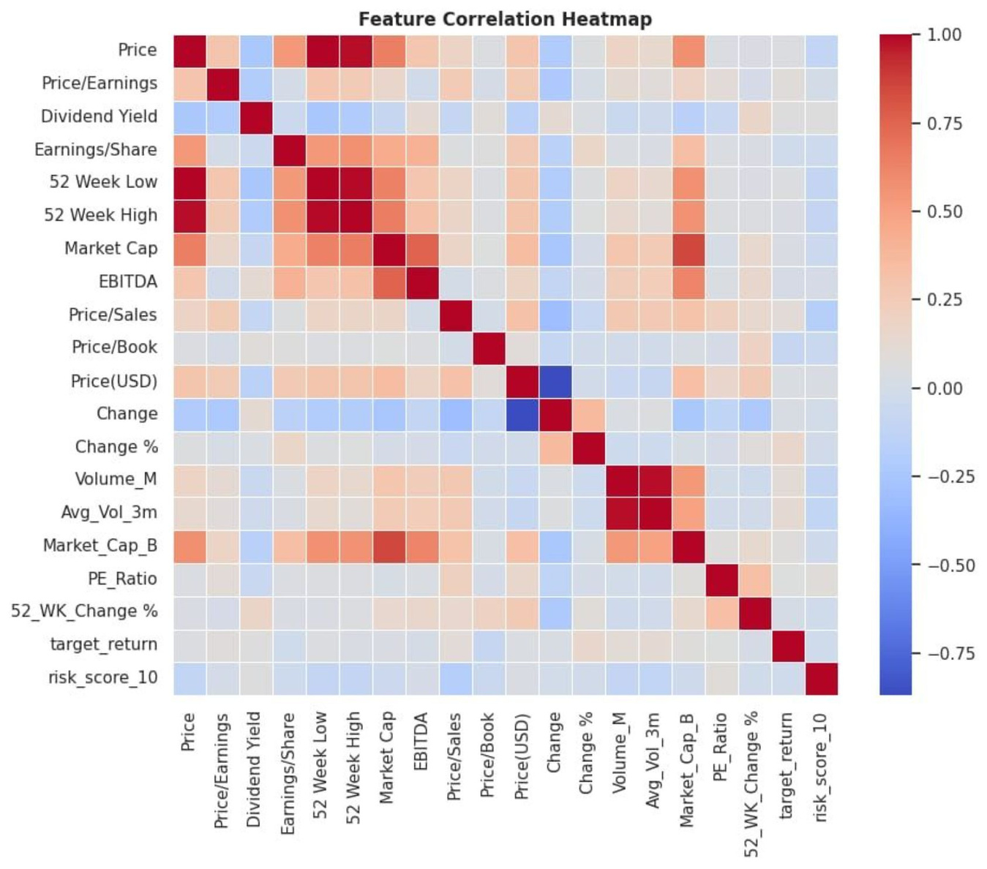

Benefits
Saves time analyzing stocks
Easy to use for beginners
Better investment decisions
Reduces financial risk
Notes:
8

Slide 9

Future Scope
Real-time news analysis
Portfolio management
Advanced AI models
Mobile application
Notes:
9

Slide 10
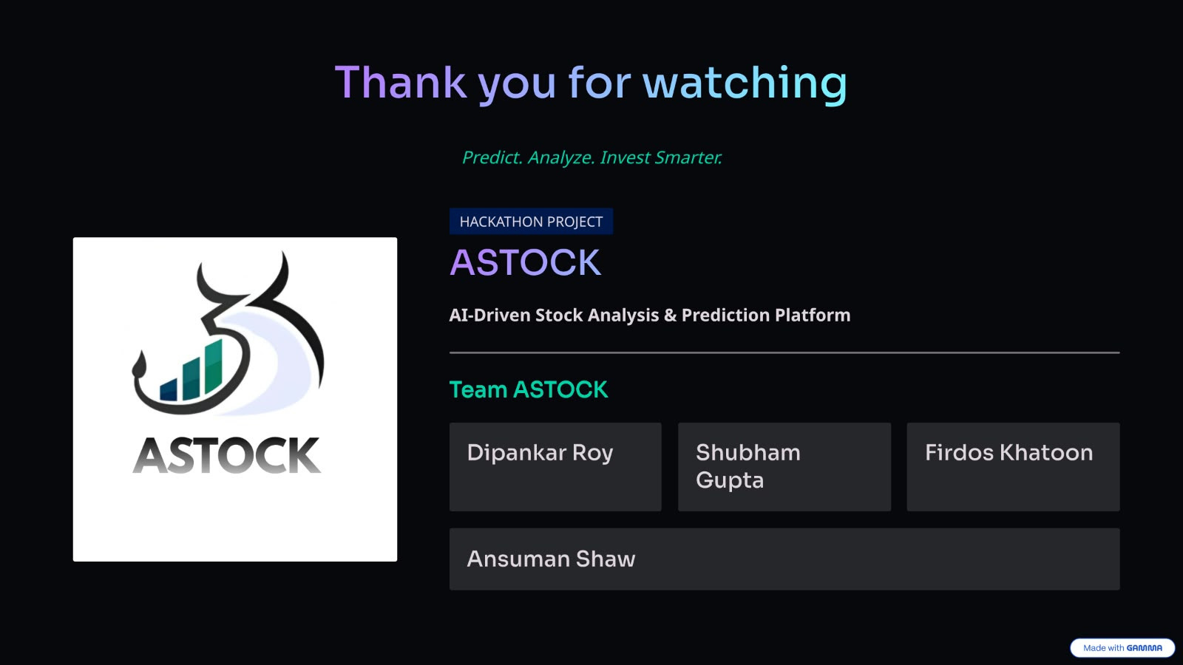
Notes:
10

Slide 11
Sources
IMG-20260829-WA0029.jpg
IMG-20260829-WA0031.jpg
IMG-20260829-WA0055.jpg
Notes:
11

